Slide 1
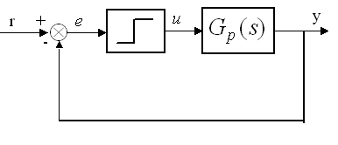
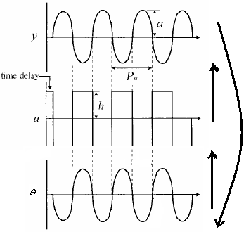
Generating Sustained Oscillation
Bring the system to steady-state
Increased u by h, (e.g., 5%)
After L, y increase, relay switches to opposite position,
As phase lag is -π, limit cycle a period P_{u} results.
Repeat to generate sustained oscillation
H, height of the relay;
a, amplitude of oscillation.

Slide 2
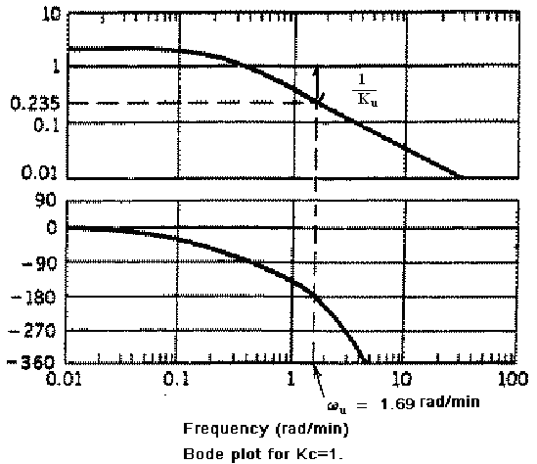
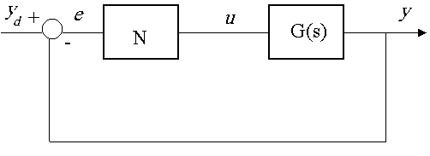
Ultimate Gain Analysis
Describing function for nonlinear system.
only the first Fourier coefficient for frequency domain analysis.
For ideal relay, A₁ = 0, B₁ = 4h/π,
relay feedback oscillation frequency corresponds to limit of stability:
the ultimate gain (K_{u}) :

Slide 3
Transfer function Modeling
Determine the model, back-calculation from gain and phase relation for parameters

Slide 4
Example: Three Parameter Model
Using gain and phase condition at ultimate frequency
either L or K_{p} needed to solve for time constant, if L available, T, and K_{p}

